Slide 1

Angular Part 7 – Reactive Forms Wednesday, January 17, 2024

Slide 2


Agenda
FormGroup
FormArray
Form Validation

Slide 3
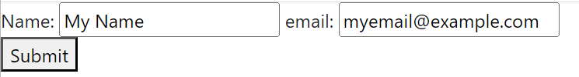
FormGroup
FormGroup is a collection of FormControl(s)
First we define formGroup directive and next to describe the FormControl(s) such as name & email
Finally we create a FormGroup using the injected FormBuilder and binds to the template formControlName and setting their values
@Component({
selector: 'app-root',
standalone: true,
imports: [CommonModule, RouterOutlet, ReactiveFormsModule],
templateUrl: './app.component.html',
styleUrl: './app.component.css'
})
export class AppComponent {
title = 'AngularPart7'
skillsForm: FormGroup
constructor (private readonly fb: FormBuilder) {
this.skillsForm = this.fb.group({
name: [‘My Name'],
email: [‘myemail@example.com']
})
}
onSubmit (): void {
console.log(`Name: ${this.skillsForm.get('name')?.value} email: ${this.skillsForm.get('email')?.value}`)
}
}
<form [formGroup]="skillsForm" (ngSubmit)="onSubmit()">
<div>
Name: <input type="text" formControlName="name" />
email: <input type="text" formControlName="email" />
</div>
<button type="submit">Submit</button>
</form>

Slide 4
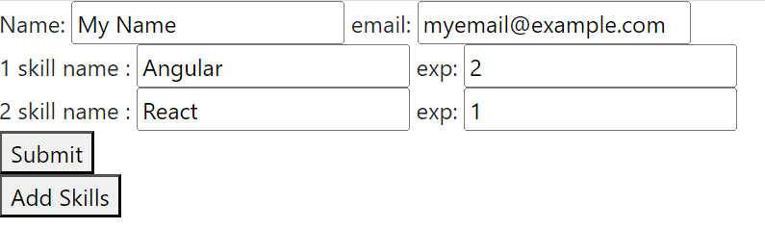
FormArray
FormArray is similar to FormGroup and it contains an array of controls
File: app.component.ts
export class AppComponent {
title = 'AngularPart7'
skillsForm: FormGroup
constructor (private readonly fb: FormBuilder) {
const fgList: FormGroup[] = []
fgList.push(this.fb.group({ skill: 'Angular', exp: 2 }))
this.skillsForm = this.fb.group({
name: ['My Name'],
email: ['myemail@example.com'],
skills: this.fb.array(fgList)
})
}
get skills (): FormArray {
return this.skillsForm.get('skills') as FormArray
}
newSkill (): FormGroup {
return this.fb.group({
skill: [‘’],
exp: [‘’]
})
}
addSkills (): void {
this.skills.push(this.newSkill())
}
File: app.component.html
<form [formGroup]="skillsForm" (ngSubmit)="onSubmit()">
<div>
Name: <input type="text" formControlName="name" />
email: <input type="text" formControlName="email" />
</div>
<div formArrayName="skills">
@for (skill of skills.controls; track skill; let idx=$index) {
<div [formGroupName]="idx">
{{idx + 1}}
skill name :
<input type="text" formControlName="skill">
exp:
<input type="text" formControlName="exp">
</div>
}
</div>
<button type="submit">Submit</button>
</form>
<button type="button" (click)="addSkills()">Add Skills</button>-->

Slide 5
FormArray
File: app.component.ts
onSubmit (): void {
console.log(`Name: ${this.skillsForm.get('name')?.value} email: ${this.skillsForm.get('email')?.value}`)
const fa = this.skillsForm.get('skills') as FormArray
for (const ae of fa.controls) {
console.log(ae.get('skill')?.value, ae.get('exp')?.value)
}

Slide 6
Form Validation
Form validation is first defined and then is reference for invalid field. Notice that it 1st check for single control then the whole form to see if there are any errors
<form [formGroup]="skillsForm" (ngSubmit)="onSubmit()">
<div>
Name: <input type="text" formControlName="name" />
<div *ngIf="skillsForm.get('name')?.invalid">
Name not valid.
</div>
email: <input type="text" formControlName="email" />
<div *ngIf="skillsForm.get('email')?.invalid">
email not valid.
</div>
</div>
<div formArrayName="skills">
@for (skillGroup of skills.controls; track skillGroup; let idx=$index) {
<div [formGroupName]="idx">
{{idx + 1}}
skill name :
<input type="text" formControlName="skill">
exp:
<input type="text" formControlName="exp">
<div *ngIf="skillGroup.get('exp')?.invalid">
Experience not valid.
</div>
</div>
}
</div>
<button type="submit">Submit</button>
</form>
<button type="button" (click)="addSkills()">Add Skills</button>
File: app.component.ts
constructor (private readonly fb: FormBuilder) {
const fgList: FormGroup[] = []
fgList.push(this.fb.group({
skill: ['Angular'],
exp: [2, [Validators.required, this.validateExp]]
}))
this.skillsForm = this.fb.group({
name: ['My Name', [Validators.required, Validators.pattern('^[A-Za-z0-9_\ -]{5,15}$')]],
email: ['myemail@example.com', [Validators.required, Validators.pattern('^[a-z0-9._%+-]+@[a-z0-9.-]+\.[a-z]{2,4}$')]],
skills: this.fb.array(fgList)
})
}
validateExp (control: AbstractControl): any {
if (isNaN(Number(control.value))) {
return { invalidExp: true }
}
return null
}

Slide 7
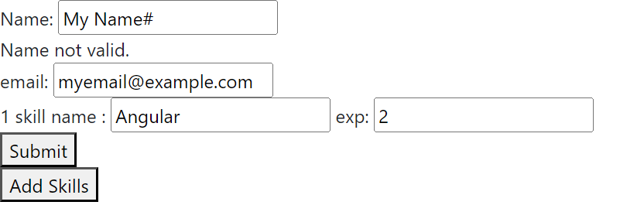
Form Validation
The below skillsForm.invalid indicates that there is an error in the validation
onSubmit (): void {
if (this.skillsForm.invalid) {
return
}
console.log(`Name: ${this.skillsForm.get('name')?.value} email: ${this.skillsForm.get('email')?.value}`)
const fa = this.skillsForm.get('skills') as FormArray
for (const ae of fa.controls) {
console.log(ae.get('skill')?.value, ae.get('exp')?.value)
}
}

Slide 8

Thank you
Sonny Hoang
sthoang62@gmail.com

